Slide 1


CS 106: Artificial Intelligence
Constraint Satisfaction Problems
Instructor: Ngoc-Hoang LUONG, PhD
University of Information Technology (UIT), VNU-HCM
[These slides were adapted from the slides created by Dan Klein and Pieter Abbeel for CS188 Intro to AI at UC Berkeley. http://ai.berkeley.edu.]
Notes:
Please retain proper attribution, including the reference to ai.berkeley.edu. Thanks!

Slide 2


What is Search For?
Assumptions about the world: a single agent, deterministic actions, fully observed state, discrete state space
Planning: sequences of actions
The path to the goal is the important thing
Paths have various costs, depths
Heuristics give problem-specific guidance
Identification: assignments to variables
The goal itself is important, not the path
All paths at the same depth (for some formulations)
CSPs are specialized for identification problems

Slide 3

Constraint Satisfaction Problems

Slide 4


Constraint Satisfaction Problems
Constraint satisfaction problems (CSPs):
A special subset of search problems
State is defined by variables X_{i} with values from a domain D (sometimes D depends on i)
Goal test is a set of constraints specifying allowable combinations of values for subsets of variables
Allows useful general-purpose algorithms with more power than standard search algorithms
Notes:
Goal test has structure, it ‘s more like a manual describing a set of constraints that have to hold true

Slide 5
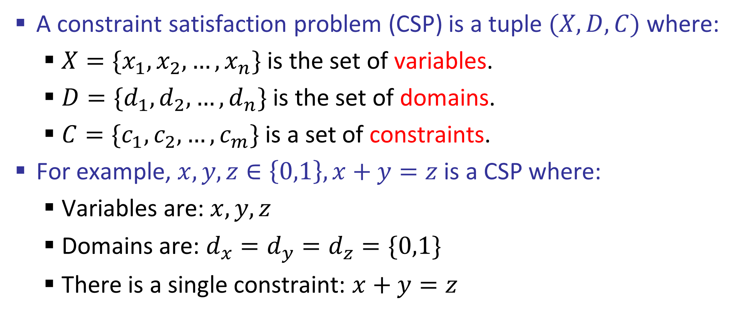
Constraint Satisfaction Problems
A constraint satisfaction problem (CSP) is a tuple $(X,D,C)$ where:
$X=\{x_{1},x_{2},…,x_{n}\}$ is the set of variables.
$D=\{d_{1},d_{2},…,d_{n}\}$ is the set of domains.
$C=\{c_{1},c_{2},…,c_{m}\}$ is a set of constraints.
For example, $x,y,z∈\left\{0,1\right\},x+y=z$ is a CSP where:
Variables are: $x,y,z$
Domains are: $d_{x}=d_{y}=d_{z}=\{0,1\}$
There is a single constraint: $x+y=z$
https://www.cs.upc.edu/~erodri/webpage/cps/cps.html

Slide 6
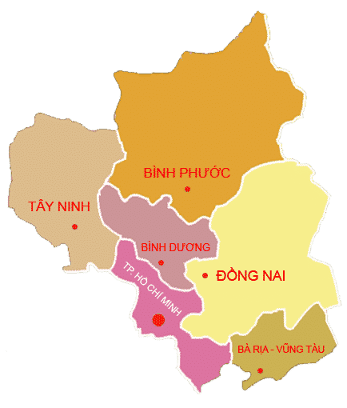
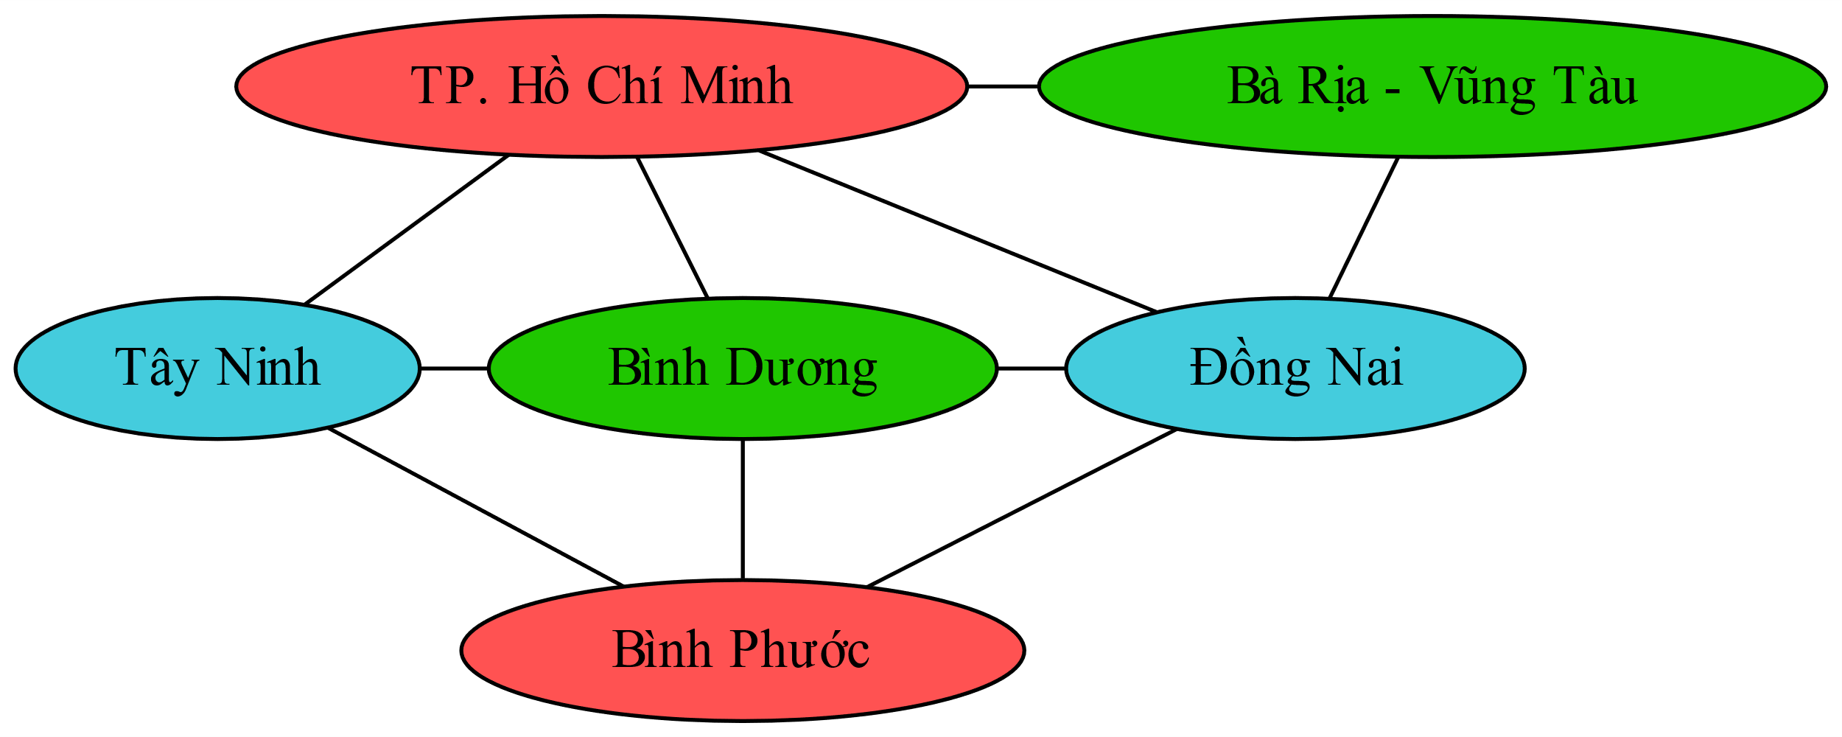
Constraint Graphs

Slide 7
Constraint Graphs
Binary CSP: each constraint relates (at most) two variables
Binary constraint graph: nodes are variables, arcs show constraints
General-purpose CSP algorithms use the graph structure to speed up search.
Notes:
Demo:
Run constraint.jar or constraint.exe, load the 5 queens problem.
Demo is just showing the n-queens applet as illustration of constraint graph, but later in lecture we’ll interact with the applet.
aispace.org will have the latest version

Slide 8
CSP Examples

Slide 9

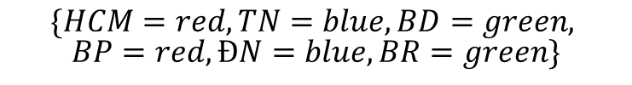
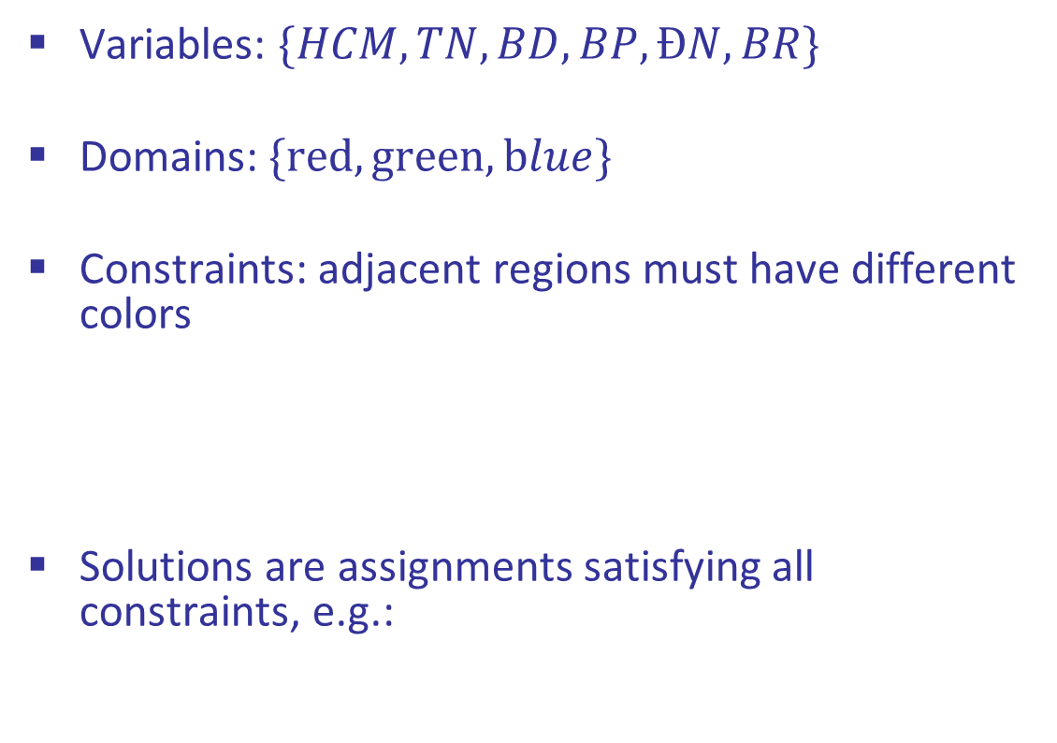
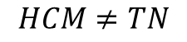
Example: Map Coloring
Variables: $\{HCM, TN, BD, BP, ĐN, BR\}$
Domains:$\{red,green,blue\}$
Constraints: adjacent regions must have different colors
Solutions are assignments satisfying all constraints, e.g.:
Implicit:
$$HCM≠TN$$
Explicit:
$$\left(HCM,TN\right)∈\{\left(red,green\right), \left(red,blue\right),…\}$$
$$\{HCM=red, TN=blue, BD=green,$$
$$BP=red, ĐN=blue, BR=green\}$$

Slide 10








Example: N-Queens
Variables:
Domains:
Constraints:
 |  | ♛
♛
 |  |  | ♛
 | ♛
Implicit:
♛
 | ♛
♛
 | ♛
Explicit:

Slide 11
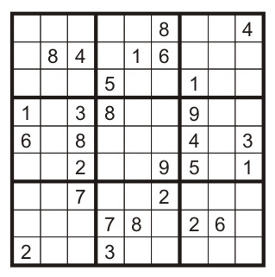
Example: Sudoku
Variables:
Each (open) square
Domains:
{1,2,…,9}
Constraints:
9-way alldiff for each column
9-way alldiff for each row
9-way alldiff for each region

Slide 12

Varieties of CSPs and Constraints

Slide 13


Varieties of CSPs
Discrete Variables
Finite domains
Size d means O(d^{n}) complete assignments
E.g., Boolean CSPs, including Boolean satisfiability (NP-complete)
Infinite domains (integers, strings, etc.)
E.g., job scheduling, variables are start/end times for each job
Continuous variables
E.g., start/end times for Hubble Telescope observations

Slide 14
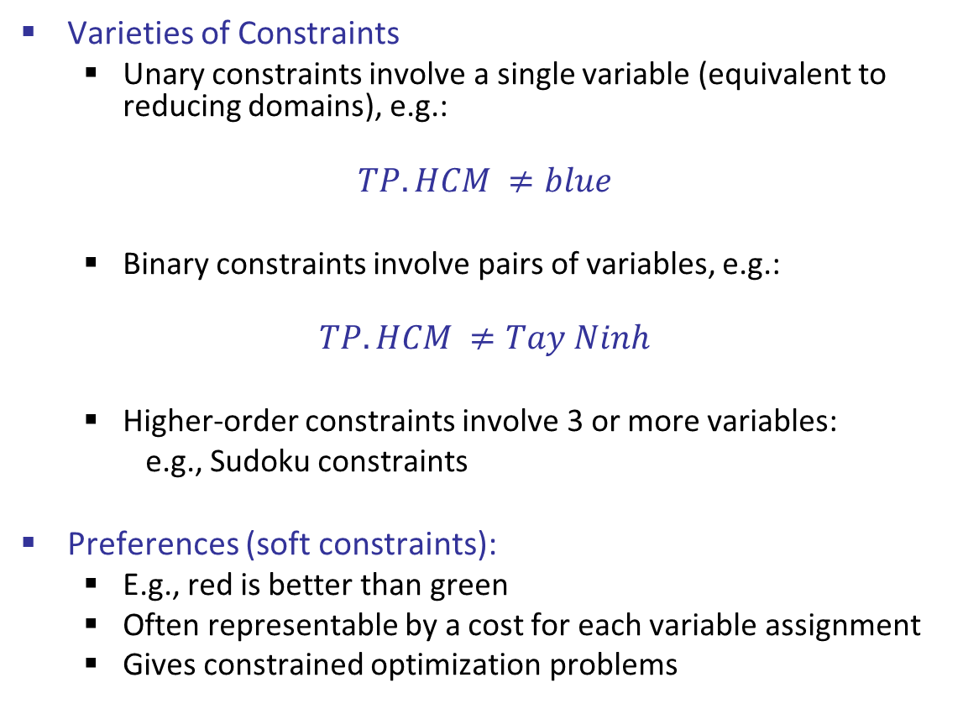
Varieties of Constraints
Varieties of Constraints
Unary constraints involve a single variable (equivalent to reducing domains), e.g.:
$$TP.HCM ≠blue$$
Binary constraints involve pairs of variables, e.g.:
$$TP.HCM ≠Tay Ninh$$
Higher-order constraints involve 3 or more variables:
e.g., Sudoku constraints
Preferences (soft constraints):
E.g., red is better than green
Often representable by a cost for each variable assignment
Gives constrained optimization problems

Slide 15
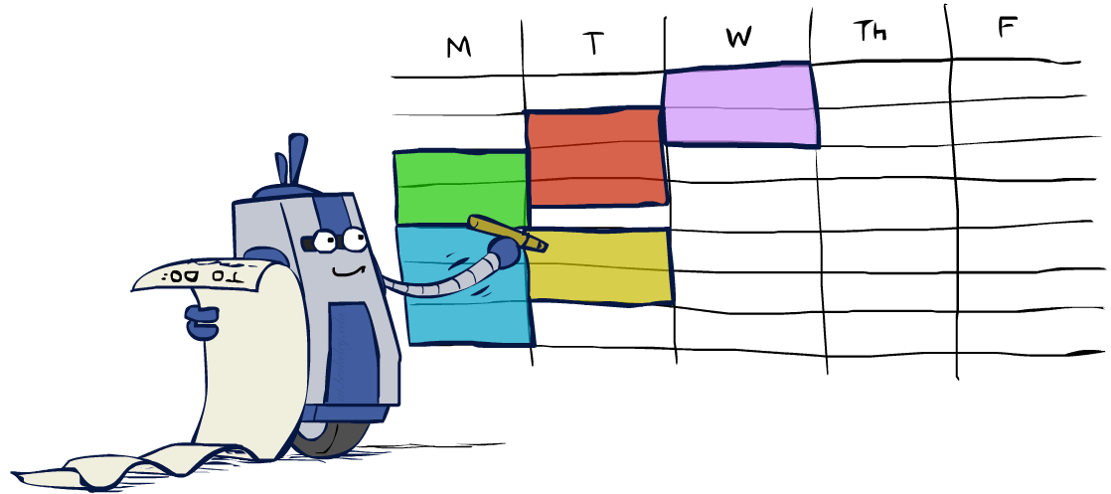
Real-World CSPs
Assignment problems: e.g., who teaches what class
Timetabling problems: e.g., which class is offered when and where?
Hardware configuration
Transportation scheduling
Factory scheduling
Circuit layout
Fault diagnosis
… lots more!
Many real-world problems involve real-valued variables…

Slide 16

Solving CSPs

Slide 17
Standard Search Formulation
Standard search formulation of CSPs
States defined by the values assigned so far (partial assignments)
Initial state: the empty assignment, {}
Successor function: assign a value to an unassigned variable
Goal test: the current assignment is complete and satisfies all constraints
We’ll start with the straightforward, naïve approach, then improve it

Slide 18
Search Methods
What would BFS do?
What would DFS do?
What problems does naïve search have?
 |  | ♛
♛
 |  |  | ♛
 | ♛
Notes:
Demo:
CS188 javascript demos -> source -> exercises -> csps -> CSPs demos -> CSPs demos.html
Settings:
Graph = Simple
Algorithm = Naïve Search
Ordering = None
Filtering = None

Slide 19
BFS?
♛
♛
 | ♛
 | ♛
 | ♛
…
 |  |  | ♛
♛
♛
♛
♛
…
…
…
…
♛
 |  |  | ♛
…
 |  |  | ♛
 |  |  | ♛
♛
♛
♛
…
♛
♛
 | ♛
…
 |  | ♛
♛
 | ♛
…
…
…
 |  | ♛
♛
 |  |  | ♛
…
 |  |  | ♛
 |  |  | ♛
 |  |  | ♛
♛
♛
♛
♛
…
♛
 | ♛
 | ♛
 |  |  | ♛
…
 |  | ♛
♛
 |  |  | ♛
 | ♛
…
♛
♛ |  | ♛
 |  | ♛
…
…
 | ♛
 |  |  | ♛
♛
 |  | ♛
…
 |  |  | ♛
♛
 |  | ♛
♛
…
…
 |  |  | ♛
 |  |  | ♛
 |  |  | ♛
 |  |  | ♛

Slide 20
DFS?
♛
♛
 | ♛
 | ♛
 | ♛
…
 |  |  | ♛
♛
♛
♛
♛
…
♛
 |  |  | ♛
♛
♛
…
♛
 | ♛
…
♛
 |  |  | ♛
♛
♛
 | ♛
…
 |  | ♛
♛
 | ♛
…
♛
 | ♛
♛
♛
♛
♛
♛
 | ♛
…
♛
♛
 | ♛
♛
♛
♛
♛
♛ | ♛
♛
♛
…
♛ |  | ♛
♛
 | ♛
…
 |  | ♛
♛
 |  |  | ♛
 | ♛
 |  | ♛
♛
 | ♛ |  | ♛
♛
♛
♛
 |  |  | ♛

Slide 21

Backtracking Search

Slide 22
Backtracking Search
Backtracking search is the basic uninformed algorithm for solving CSPs
Idea 1: One variable at a time
Only need to consider assignments to a single variable at each step
Idea 2: Check constraints as you go
i.e. consider only values which do not conflict previous assignments
Might have to do some computation to check the constraints
“Incremental goal test”
Depth-first search with these two improvements
is called backtracking search (not the best name)
Can solve n-queens for n ≈ 25

Slide 23
Backtracking Example
♛
♛
♛
♛
♛
 | ♛
♛
 | ♛
♛
 | ♛
♛
 |  | ♛
 | ♛
 |  | ♛
♛
 | ♛
 |  | ♛
♛
 |  |  | ♛
 | ♛

Slide 24
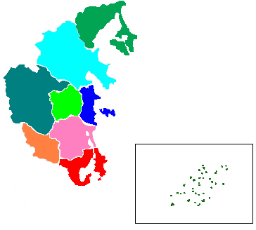
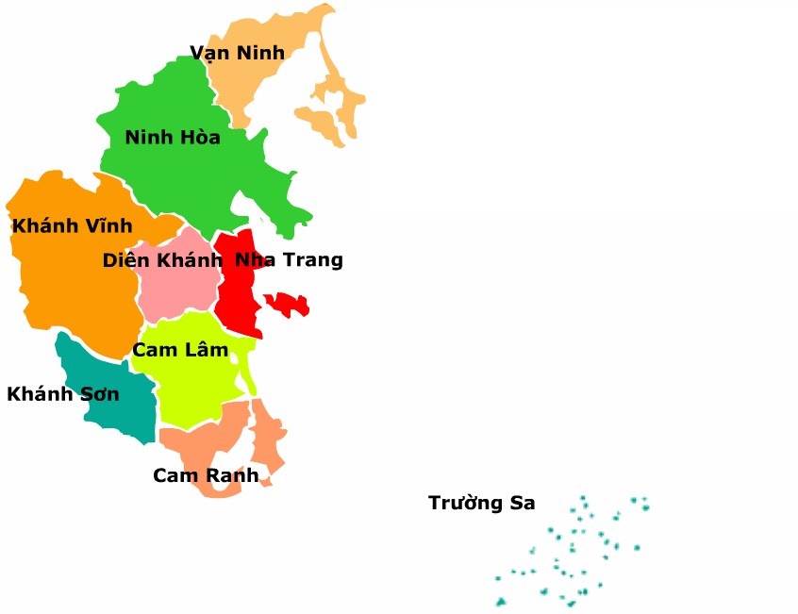
Map Coloring with Backtracking
Where are we now?
https://vi.wikipedia.org/

Slide 25
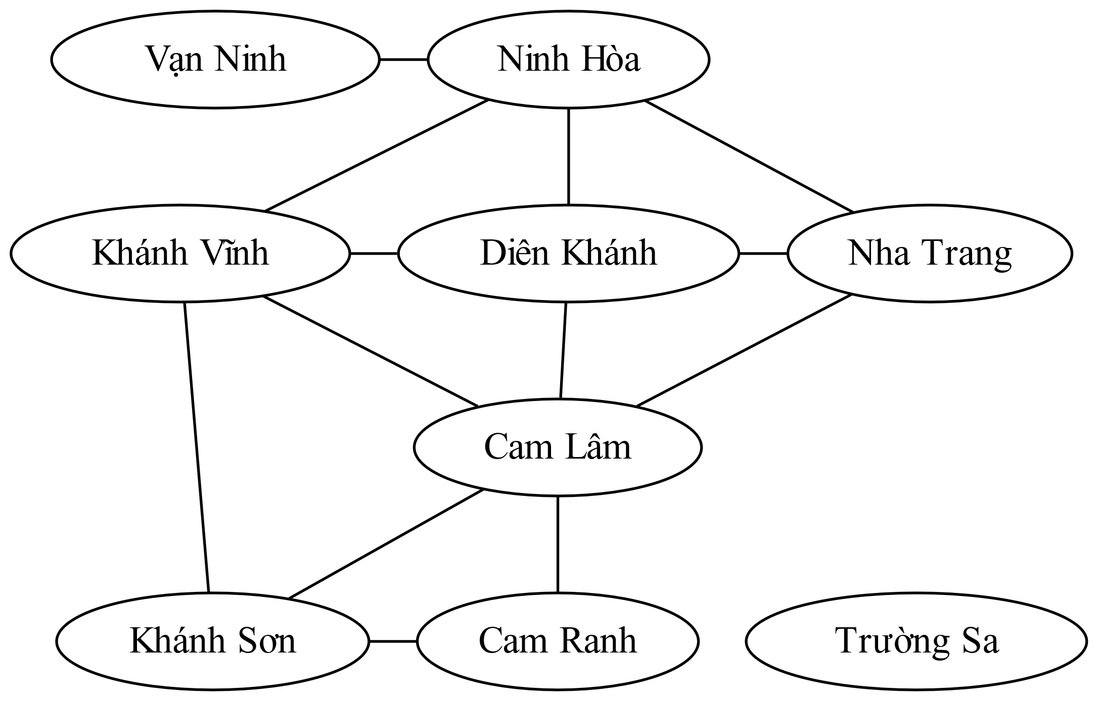
Map Coloring with Backtracking
https://camranhcitygate.info/

Slide 26
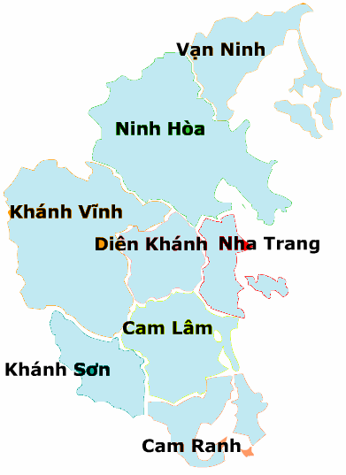
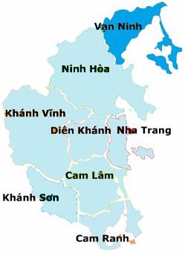
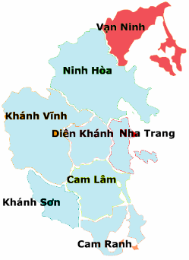
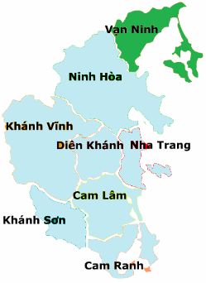
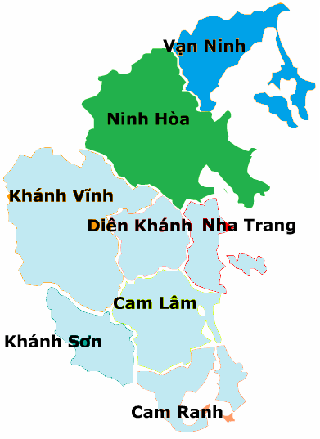
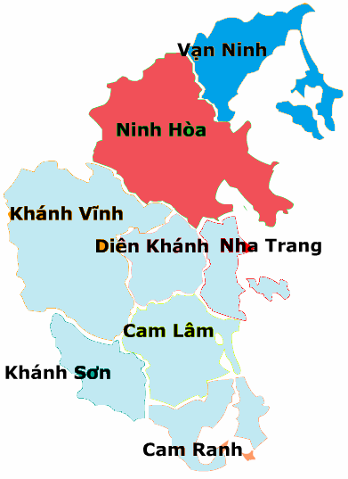
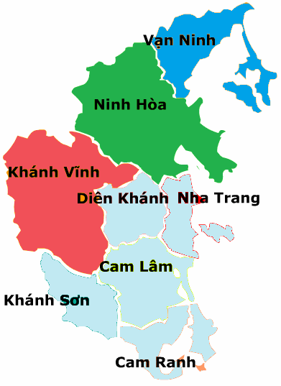
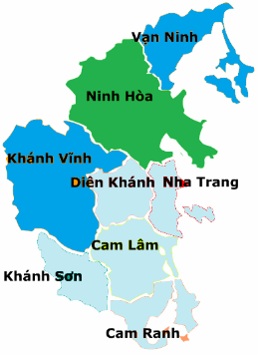
Backtracking Example

Slide 27
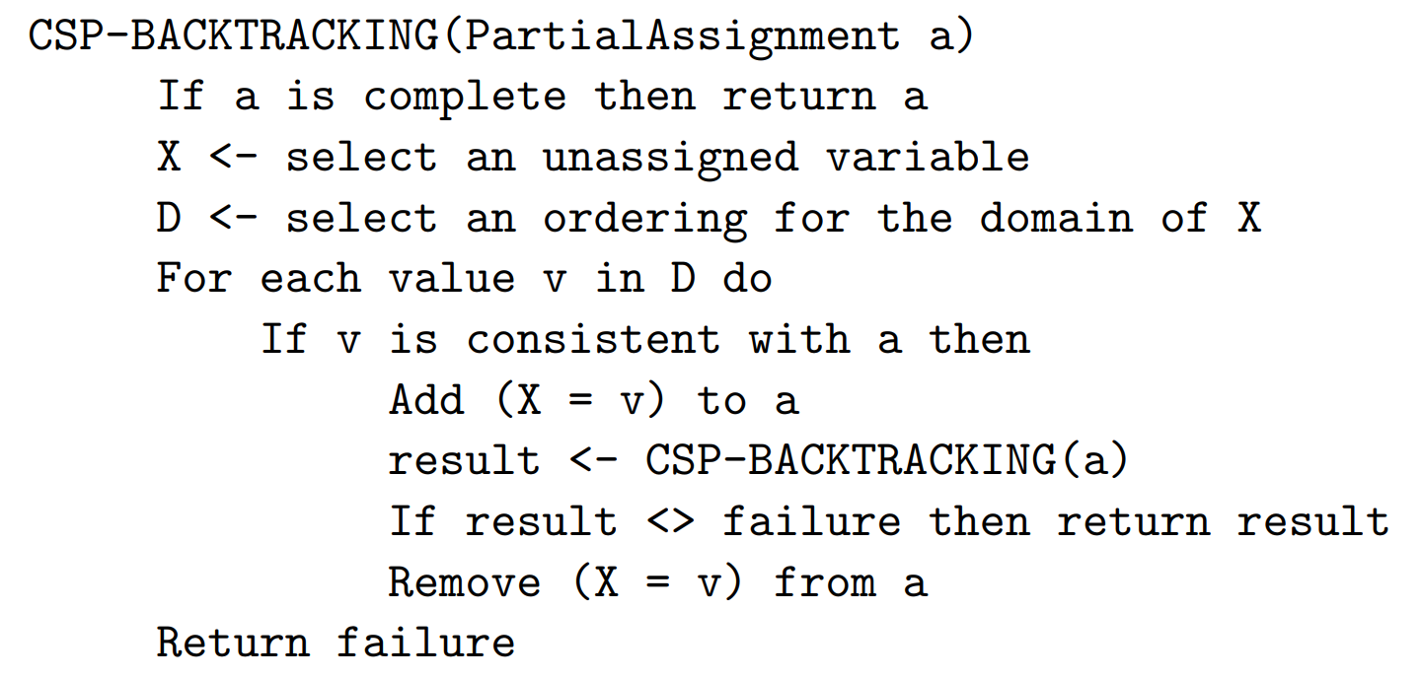
Backtracking Search
Backtracking = DFS + variable-ordering + fail-on-violation
What are the choice points?
https://www.dcc.fc.up.pt/~ines/aulas/1617/IA/cspNew.pdf
Notes:
Demo:
CS188 javascript demos -> source -> exercises -> csps -> CSPs demos -> CSPs demos.html
Settings:
Graph = Simple
Algorithm = Backtracking
Ordering = None
Filtering = None

Slide 28

Improving Backtracking
General-purpose ideas give huge gains in speed
Filtering: Can we detect inevitable failure early?
Ordering:
Which variable should be assigned next?
In what order should its values be tried?
Structure: Can we exploit the problem structure?

Slide 29

Filtering

Slide 30
Filtering: Forward Checking
Filtering: Keep track of domains for unassigned variables and cross off bad options
Forward checking: Cross off values that violate a constraint when added to the existing assignment
Notes:
Demo:
CS188 javascript demos -> source -> exercises -> csps -> CSPs demos -> CSPs demos.html
Settings:
Graph = Simple
Algorithm = Backtracking
Ordering = None
Filtering = Forward Checking

Slide 31
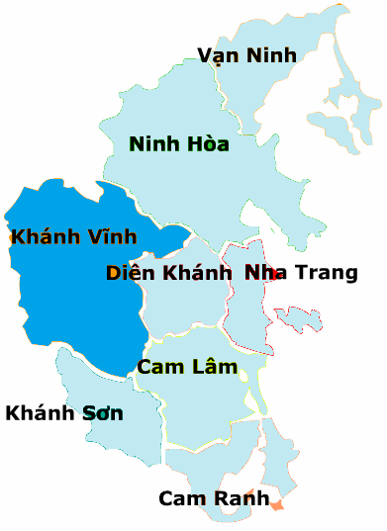
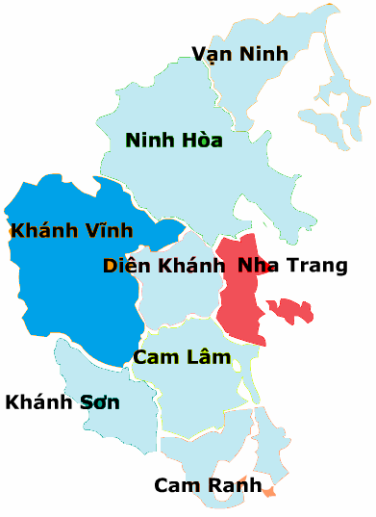
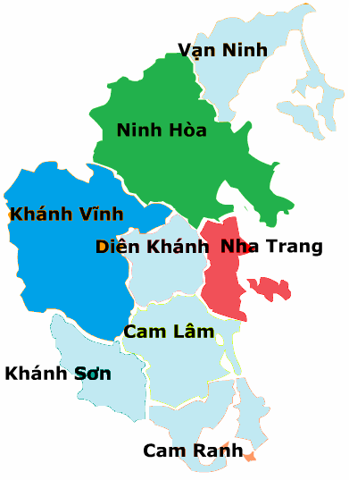
Filtering: Forward Checking
Vạn Ninh |  |  | Ninh Hòa |  |  | Khánh Vĩnh |  |  | Diên Khánh |  |  | Nha Trang |  |  | Cam Lâm |  |  | Khánh Sơn |  |  | Cam Ranh |  |  | Trường Sa

Slide 32
Filtering: Constraint Propagation
Forward checking propagates information from assigned to unassigned variables, but doesn't provide early detection for all failures:
Ninh Hòa and Diên Khánh cannot both be green!
Why didn’t we detect this yet?
Constraint propagation: reason from constraint to constraint
Vạn Ninh |  |  | Ninh Hòa |  |  | Khánh Vĩnh |  |  | Diên Khánh |  |  | Nha Trang |  |  | Cam Lâm |  |  | Khánh Sơn |  |  | Cam Ranh |  |  | Trường Sa

Slide 33

Consistency of A Single Arc
An arc X → Y is consistent iff for every x in the tail there is some y in the head which could be assigned without violating a constraint
Forward checking: Enforcing consistency of arcs pointing to each new assignment
Vạn Ninh |  |  | Ninh Hòa |  |  | Khánh Vĩnh | Diên Khánh |  |  | Nha Trang |  |  | Cam Lâm |  |  | Khánh Sơn |  |  | Cam Ranh |  |  | Trường Sa
Delete from the tail!

Slide 34
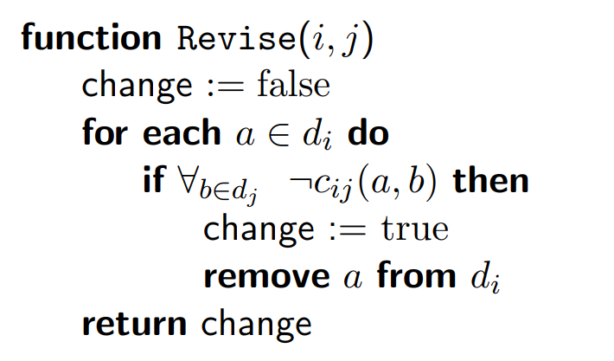
Consistency of A Single Arc
$Revise(i,j)$ removes values from $d_{i}$ without support in $d_{j}$.
https://www.cs.upc.edu/~erodri/webpage/cps/cps.html

Slide 35
Arc Consistency of an Entire CSP
A simple form of propagation makes sure all arcs are consistent:
Important: If X loses a value, neighbors of X need to be rechecked!
Arc consistency detects failure earlier than forward checking
Can be run as a preprocessor or after each assignment
What’s the downside of enforcing arc consistency?
Vạn Ninh |  |  | Ninh Hòa |  |  | Khánh Vĩnh | Diên Khánh |  |  | Nha Trang | Cam Lâm |  |  | Khánh Sơn |  |  | Cam Ranh |  |  | Trường Sa
Remember: Delete from the tail!

Slide 36
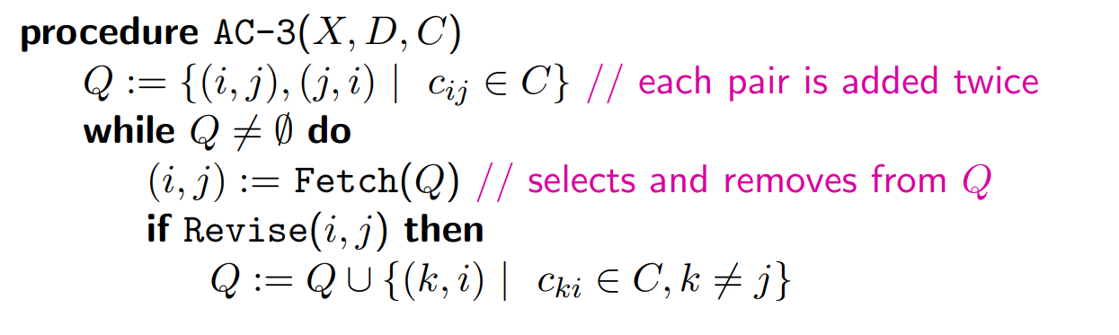
Enforcing Arc Consistency in a CSP
https://www.cs.upc.edu/~erodri/webpage/cps/cps.html
Notes:
Auto-consistency (note initially nothing gets deleted/pruned since there are consistent options for all constraints for initial variable domains)
Flashes whenever something needs to be re-checked

Slide 37
Limitations of Arc Consistency
After enforcing arc consistency:
Can have one solution left
Can have multiple solutions left
Can have no solutions left (and not know it)
Arc consistency still runs inside a backtracking search!
What went wrong here?
Notes:
Demo:
CS188 javascript demos -> source -> exercises -> csps -> CSPs demos -> CSPs demos.html
Settings:
Graph = Complex
Algorithm = Backtracking
Ordering = None
Filtering = Forward Checking (first) / Arc Consistency (second)

Slide 38
K-Consistency
Increasing degrees of consistency
1-Consistency (Node Consistency): Each single node’s domain has a value which meets that node’s unary constraints
2-Consistency (Arc Consistency): For each pair of nodes, any consistent assignment to one can be extended to the other
K-Consistency: For each k nodes, any consistent assignment to k-1 can be extended to the k^{th} node.
Higher k more expensive to compute
(You need to know the k=2 case: arc consistency)

Slide 39
Improving Backtracking
General-purpose ideas give huge gains in speed
Filtering: Can we detect inevitable failure early?
Ordering:
Which variable should be assigned next?
In what order should its values be tried?
Structure: Can we exploit the problem structure?

Slide 40

Ordering

Slide 41
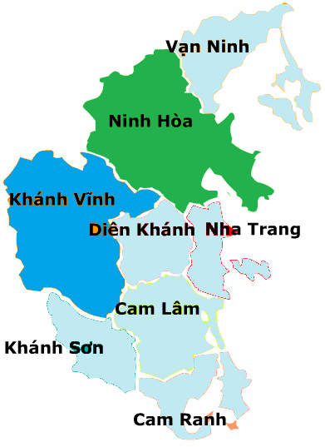
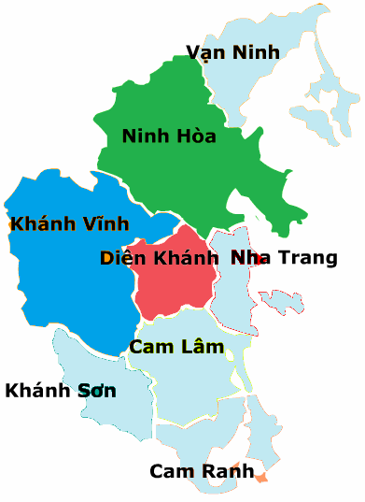
Ordering: Minimum Remaining Values
Variable Ordering: Minimum remaining values (MRV):
Choose the variable with the fewest legal left values in its domain
Vạn Ninh |  |  | Ninh Hòa |  |  | Khánh Vĩnh | Diên Khánh |  |  | Nha Trang |  |  | Cam Lâm |  |  | Khánh Sơn |  |  | Cam Ranh |  |  | Trường Sa

Slide 42

Ordering: Minimum Remaining Values
Variable Ordering: Minimum remaining values (MRV):
Choose the variable with the fewest legal left values in its domain
Why min rather than max?
Also called “most constrained variable”
“Fail-fast” ordering

Slide 43
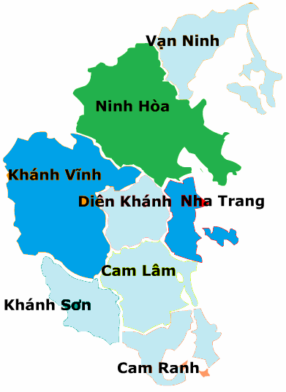

Ordering: Least Constraining Value
Value Ordering: Least Constraining Value
Given a choice of variable, choose the least constraining value (i.e., the one that rules out the fewest values in the remaining variables).
Vạn Ninh |  |  | Ninh Hòa | Khánh Vĩnh | Diên Khánh |  |  | Nha Trang |  |  | Cam Lâm |  |  | Khánh Sơn |  |  | Cam Ranh |  |  | Trường Sa

Slide 44

Ordering: Least Constraining Value
Value Ordering: Least Constraining Value
Given a choice of variable, choose the least constraining value
I.e., the one that rules out the fewest values in the remaining variables
Note that it may take some computation to determine this! (E.g., rerunning filtering)
Why least rather than most?
Combining these ordering ideas makes
1000 queens feasible

Slide 45
Improving Backtracking
General-purpose ideas give huge gains in speed
Filtering: Can we detect inevitable failure early?
Ordering:
Which variable should be assigned next?
In what order should its values be tried?
Structure: Can we exploit the problem structure?

Slide 46
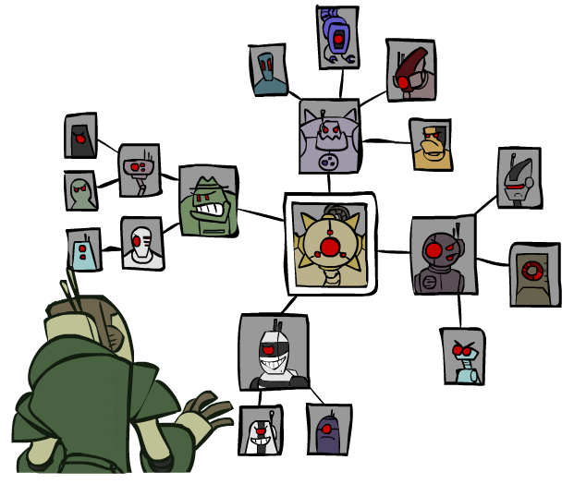
Structure

Slide 47
Problem Structure
Extreme case: independent subproblems
Example: Tasmania and mainland do not interact
Independent subproblems are identifiable as connected components of constraint graph
Suppose a graph of n variables can be broken into subproblems of only c variables:
Worst-case solution cost is O((n/c)(d^{c})), linear in n
E.g., n = 80, d = 2, c =20
2⁸⁰ = 4 billion years at 10 million nodes/sec
(4)(2²⁰) = 0.4 seconds at 10 million nodes/sec

Slide 48
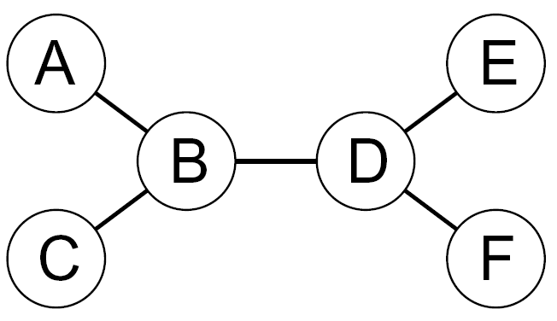
Tree-Structured CSPs
Theorem: if the constraint graph has no loops, the CSP can be solved in O(n d²) time
Compare to general CSPs, where worst-case time is O(d^{n})

Slide 49
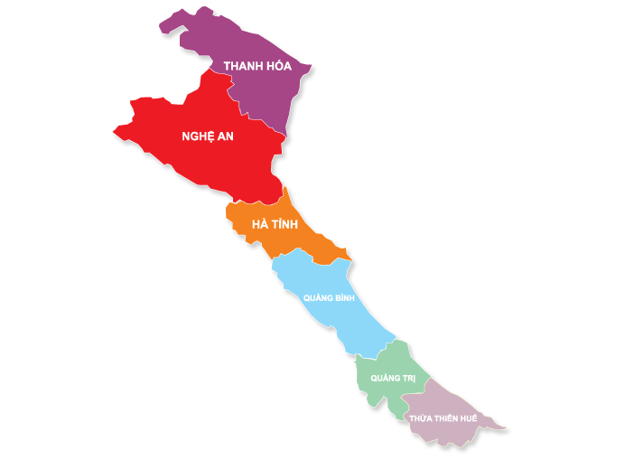
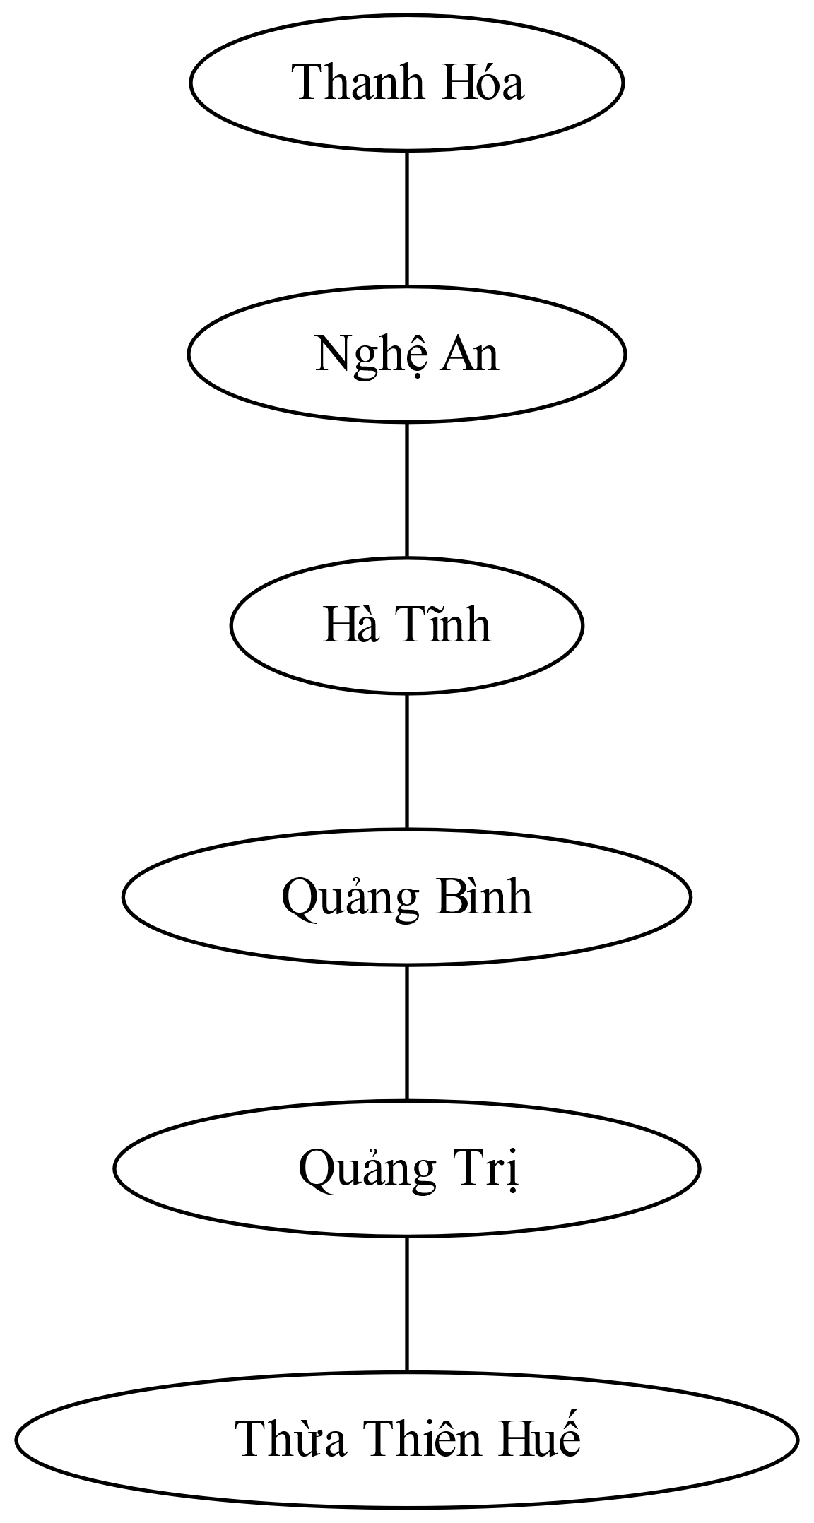
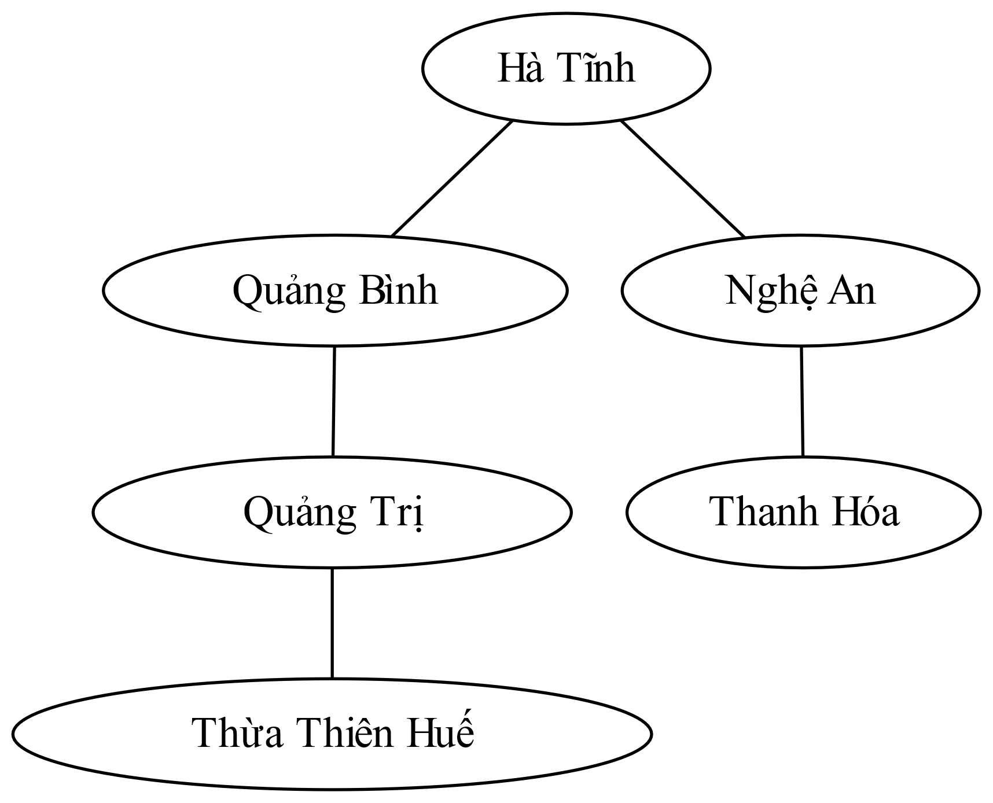
Tree-Structured CSPs

Slide 50
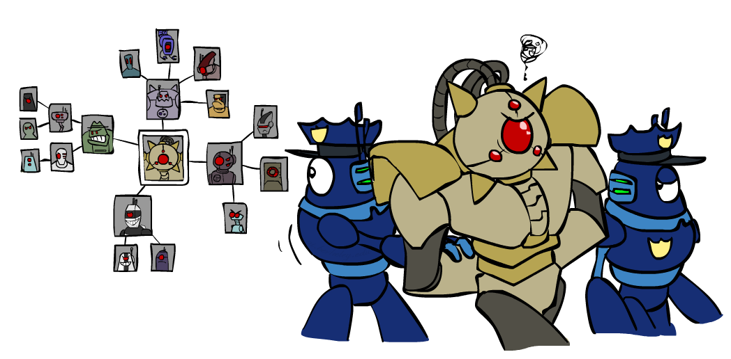
Improving Structure

Slide 51
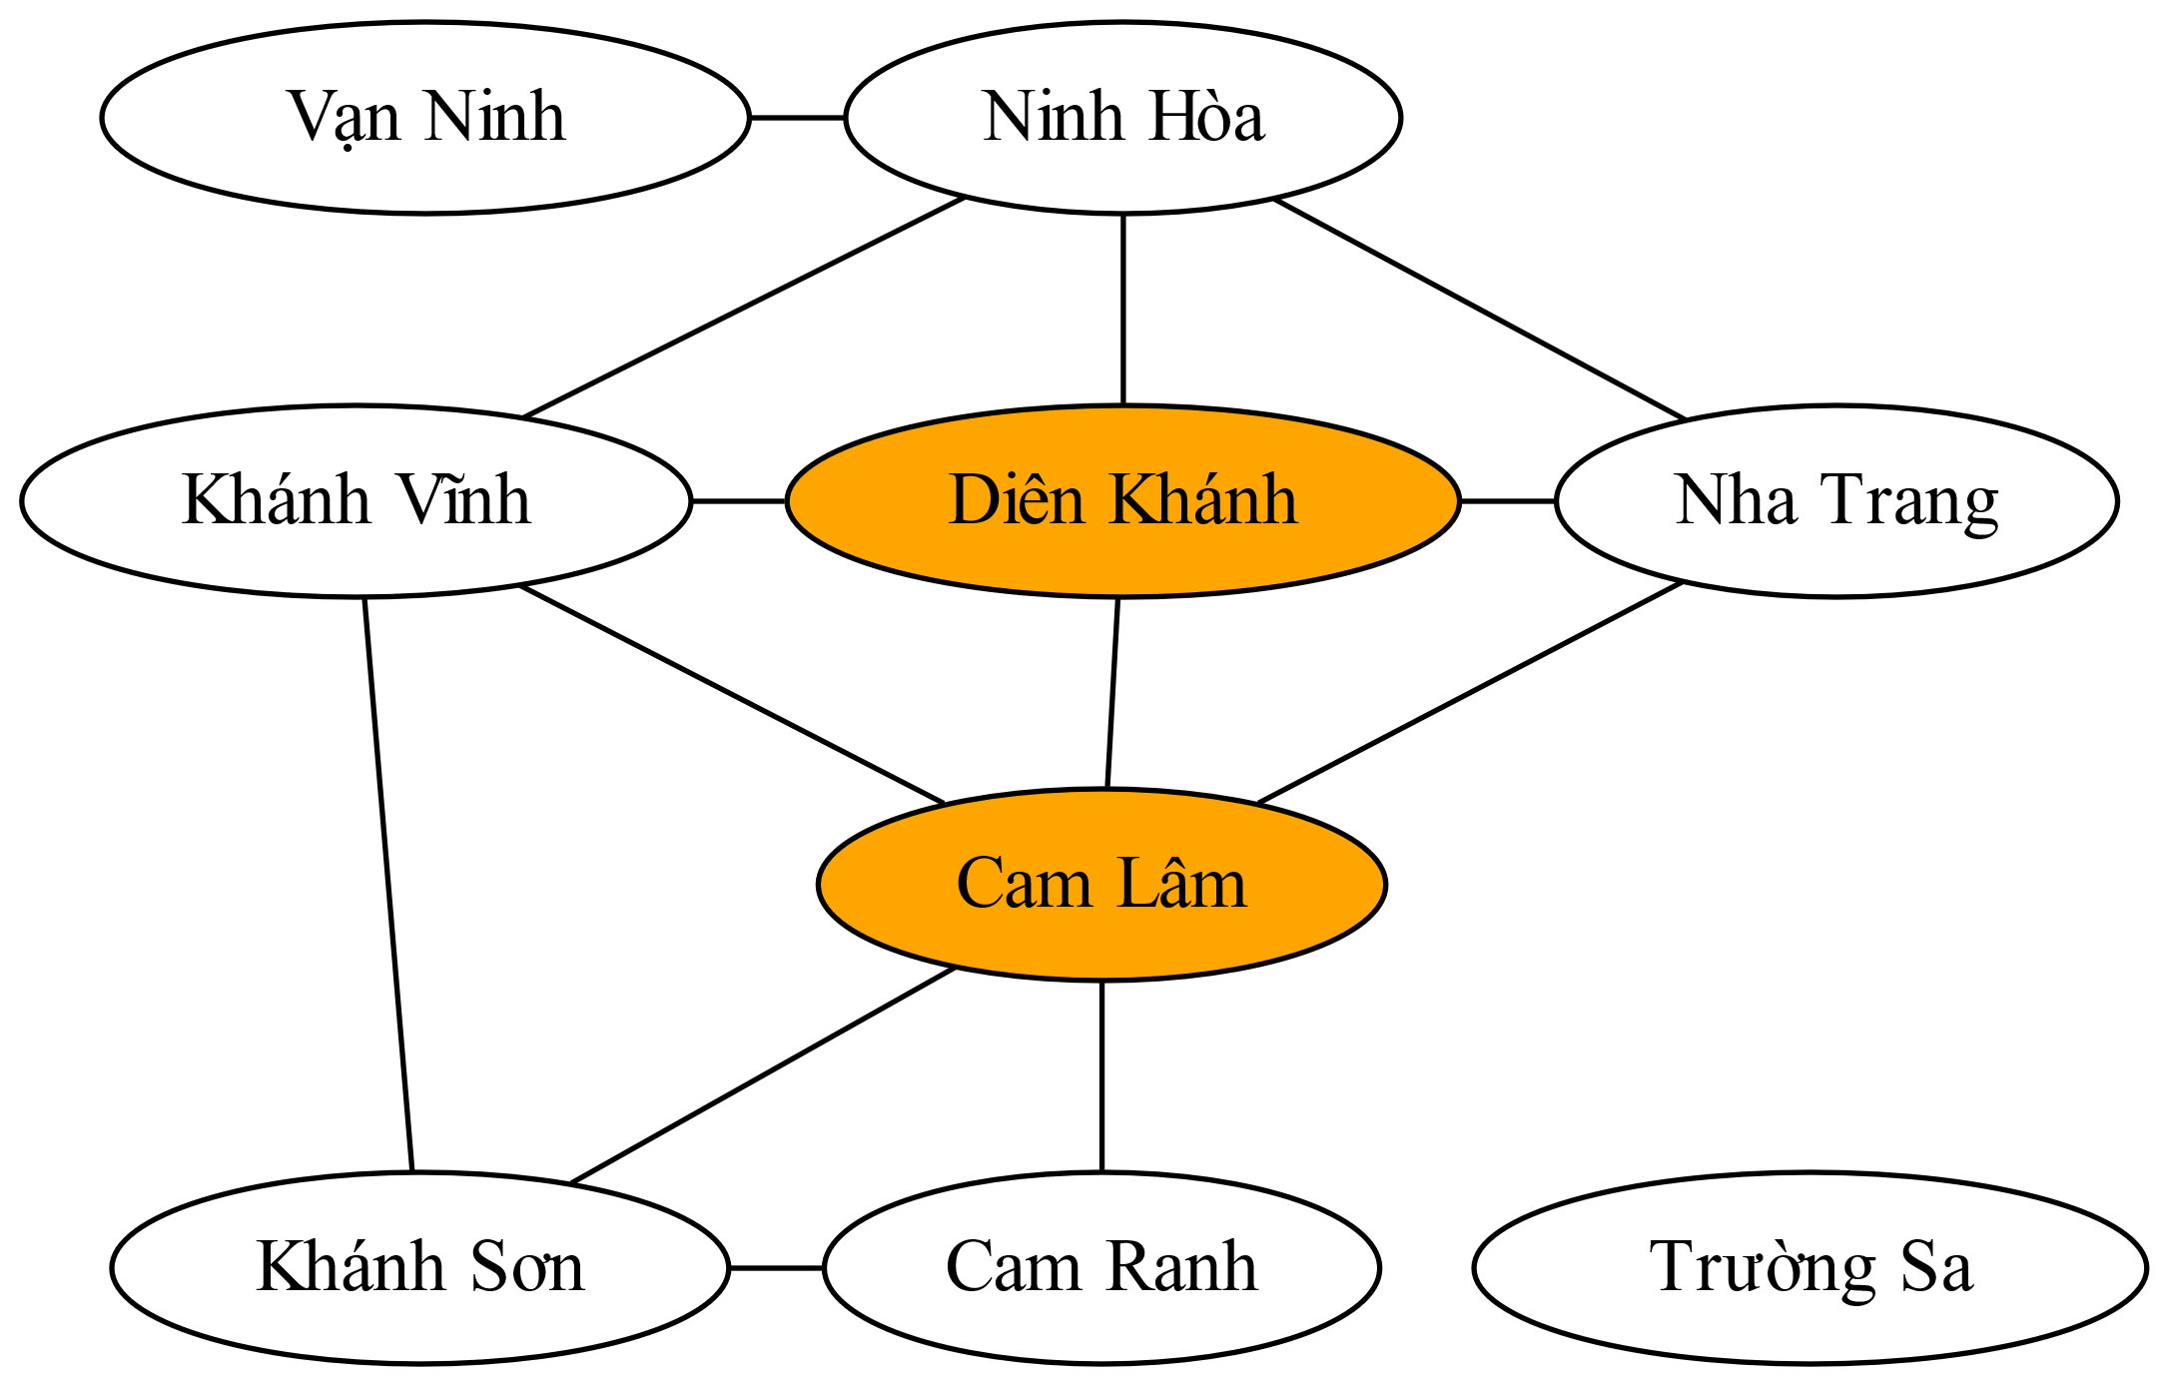
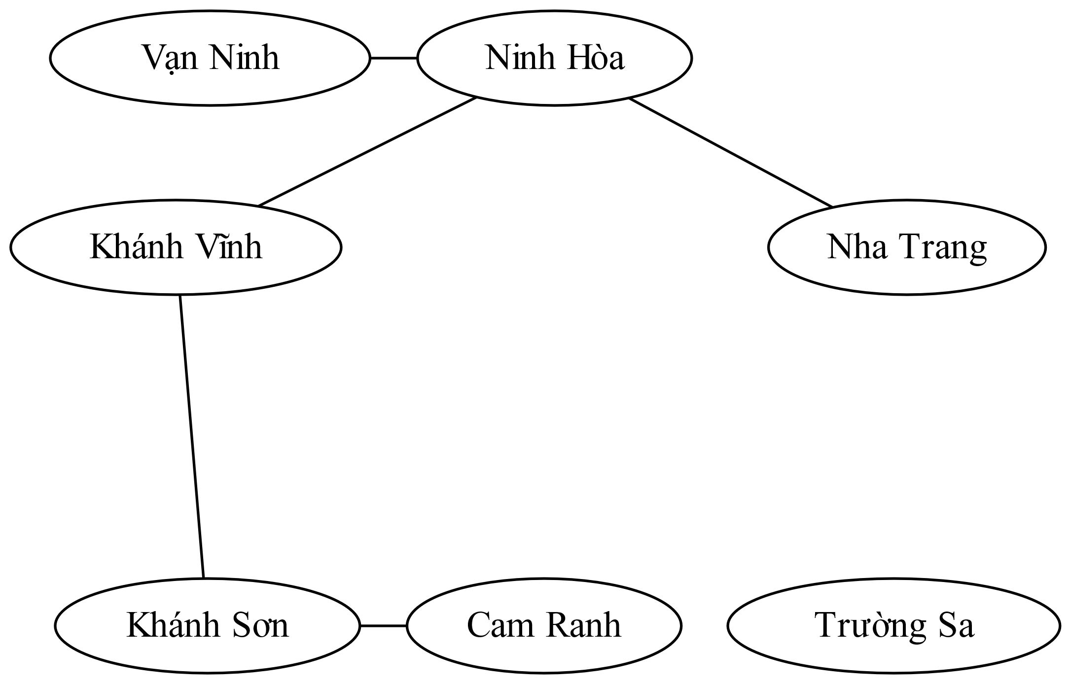
Nearly Tree-Structured CSPs
Conditioning: instantiate a variable, prune its neighbors' domains
Cutset conditioning: instantiate (in all ways) a set of variables such that the remaining constraint graph is a tree

Slide 52
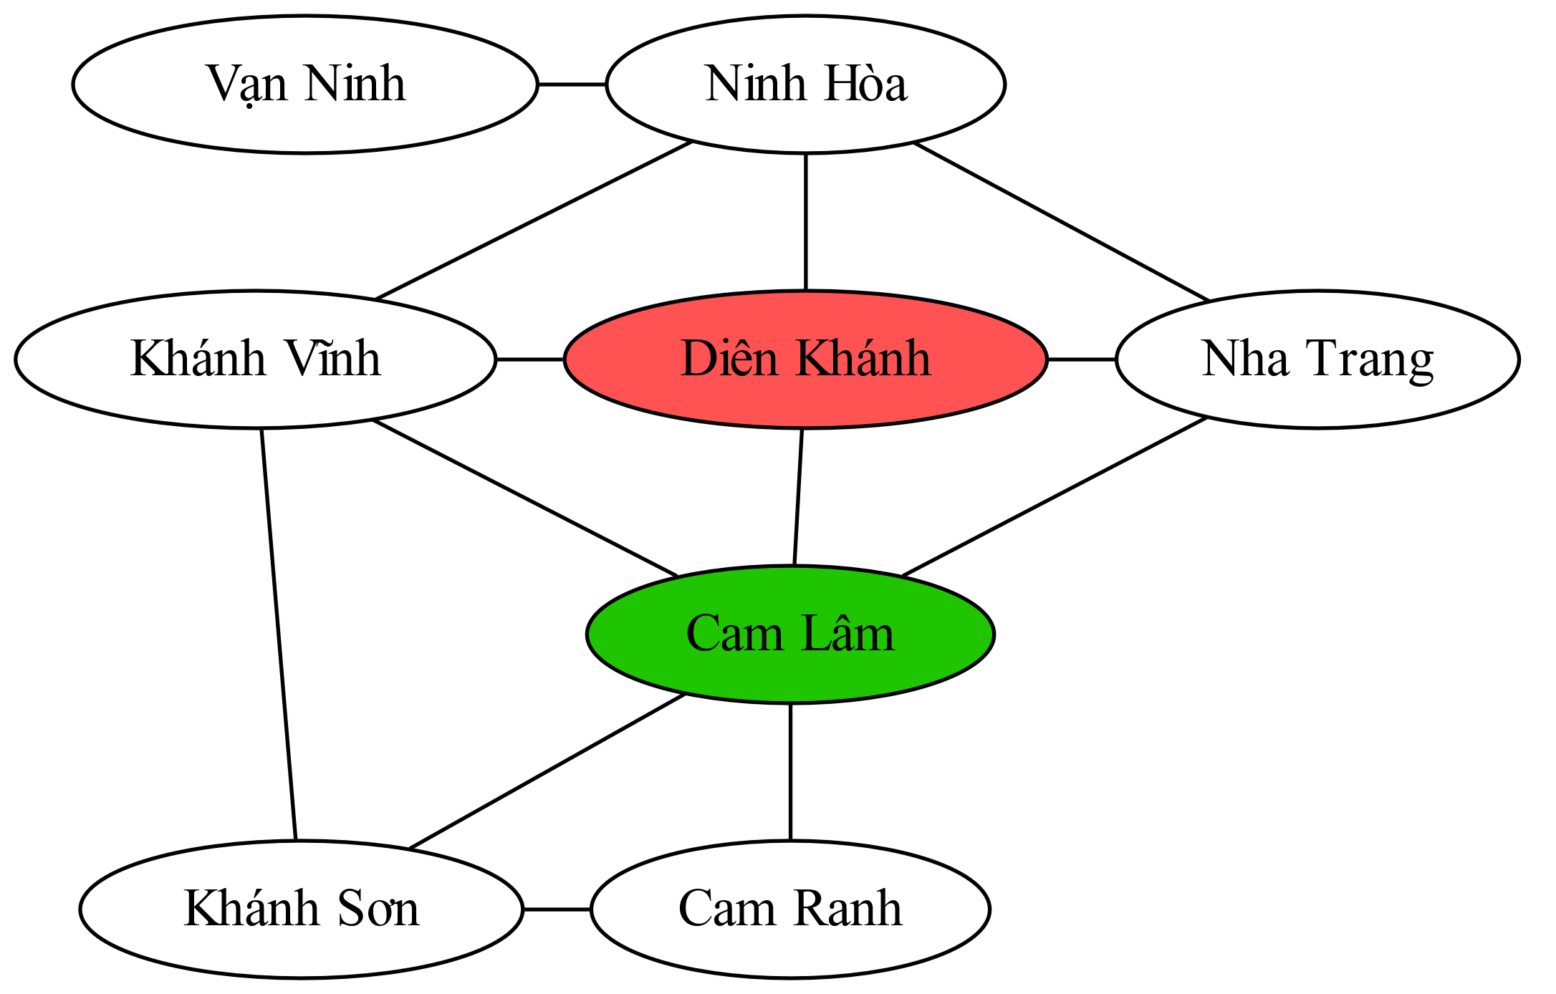
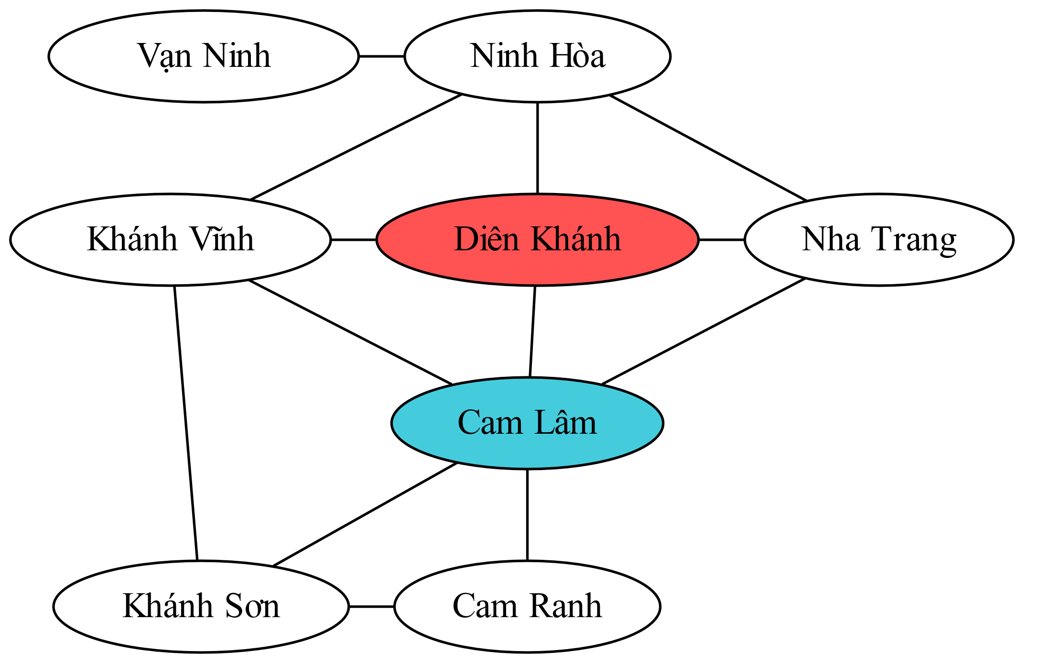
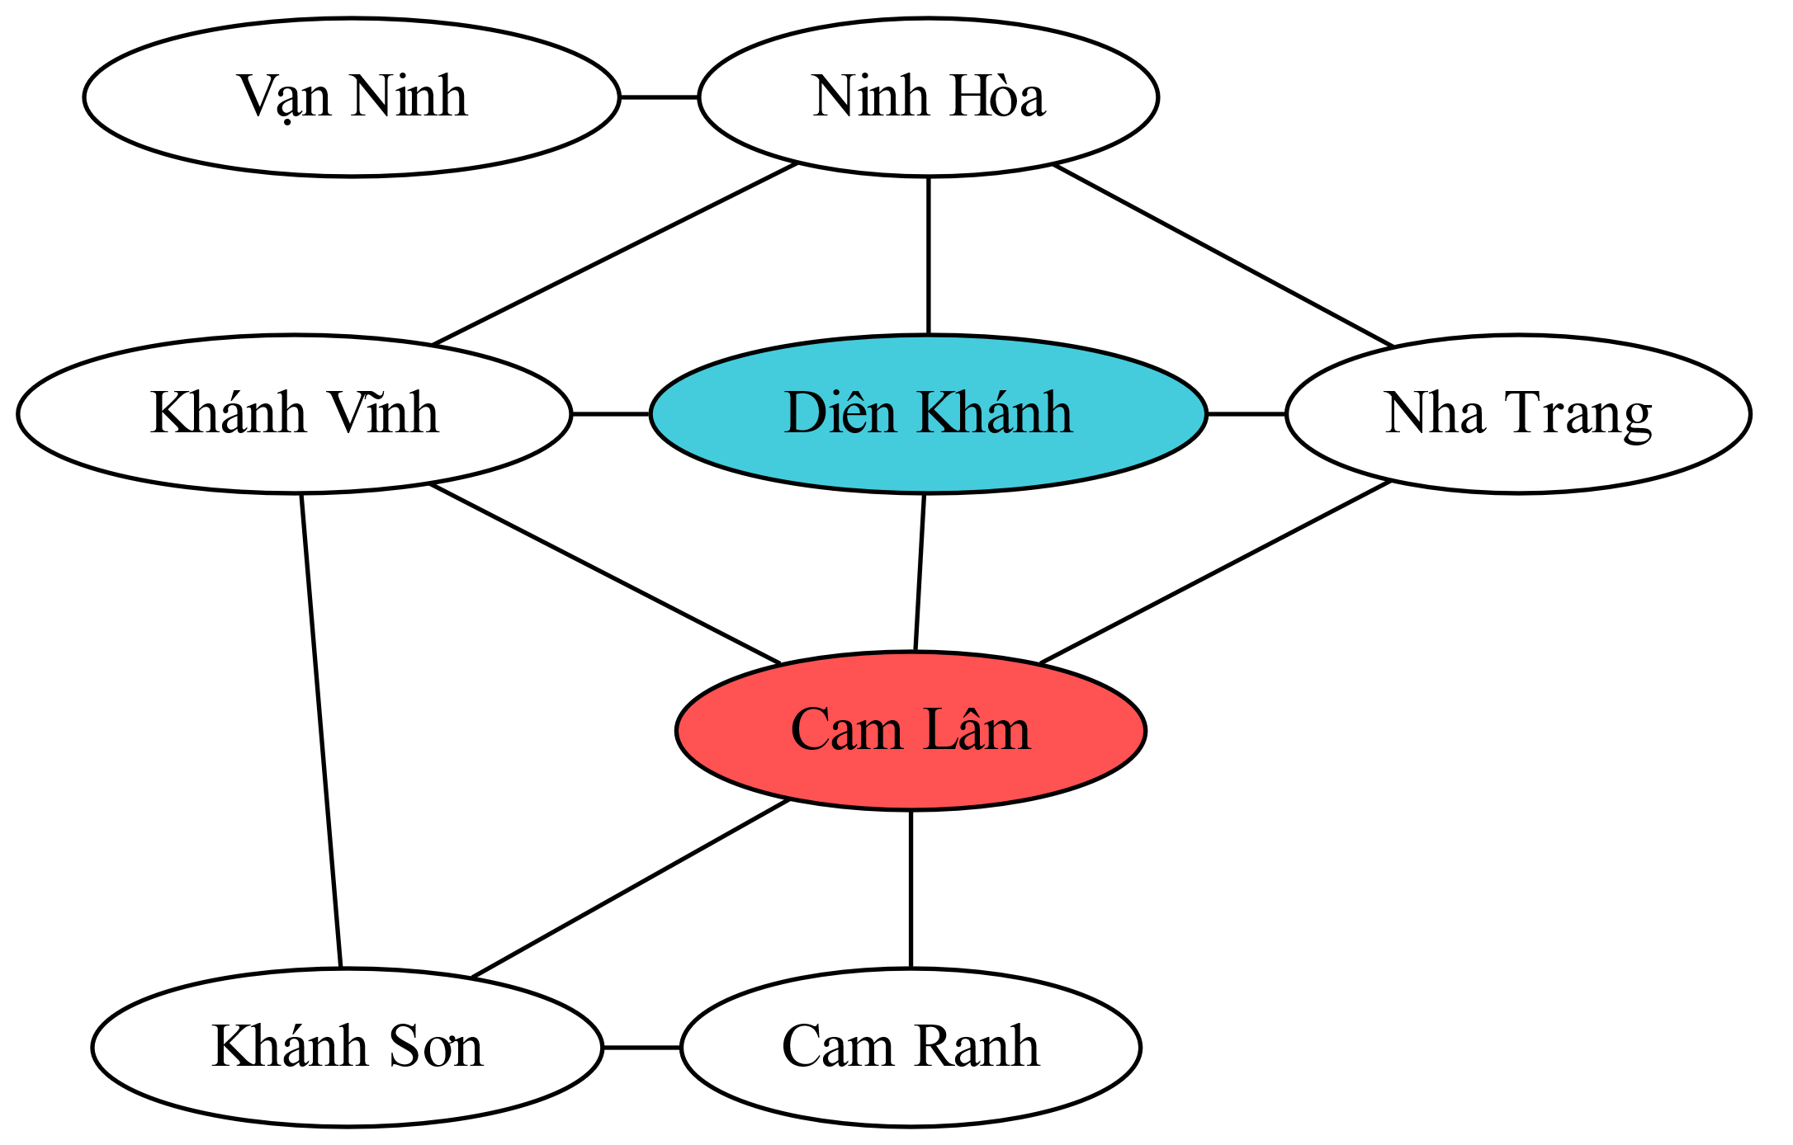
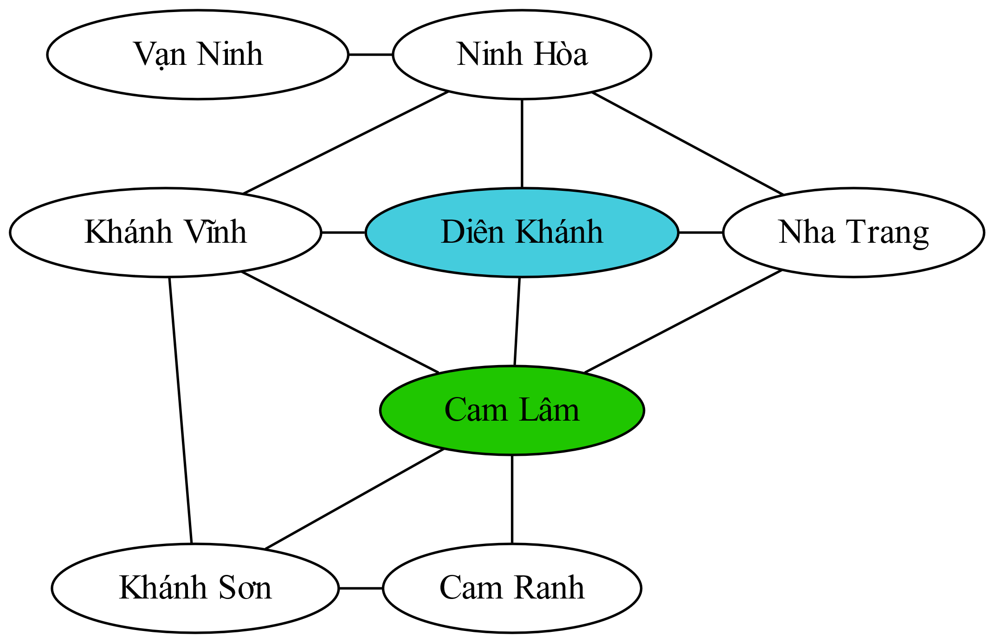
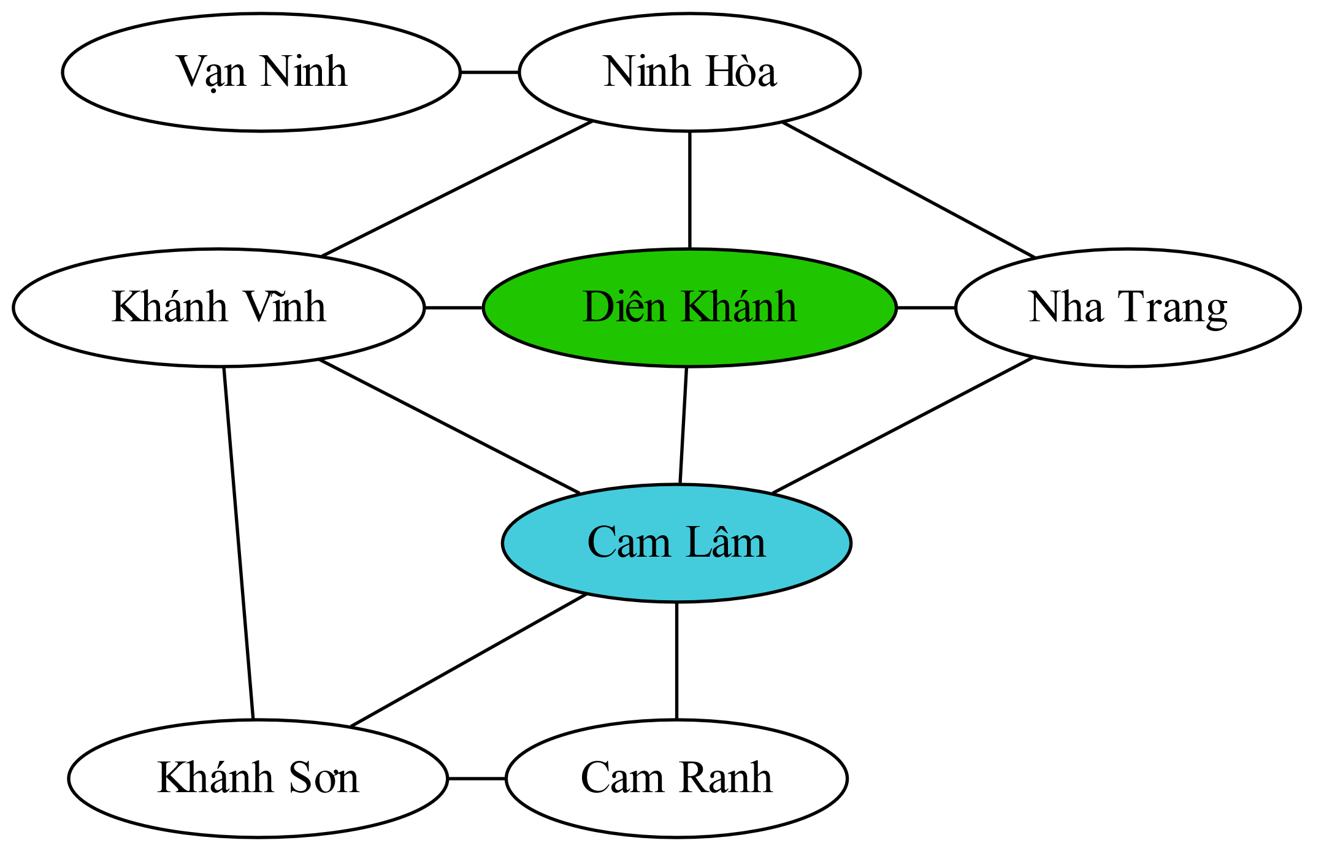
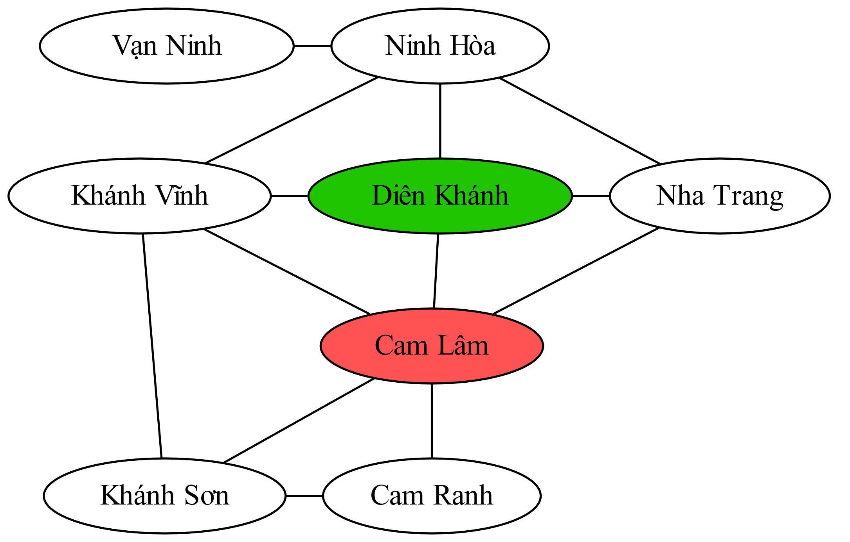
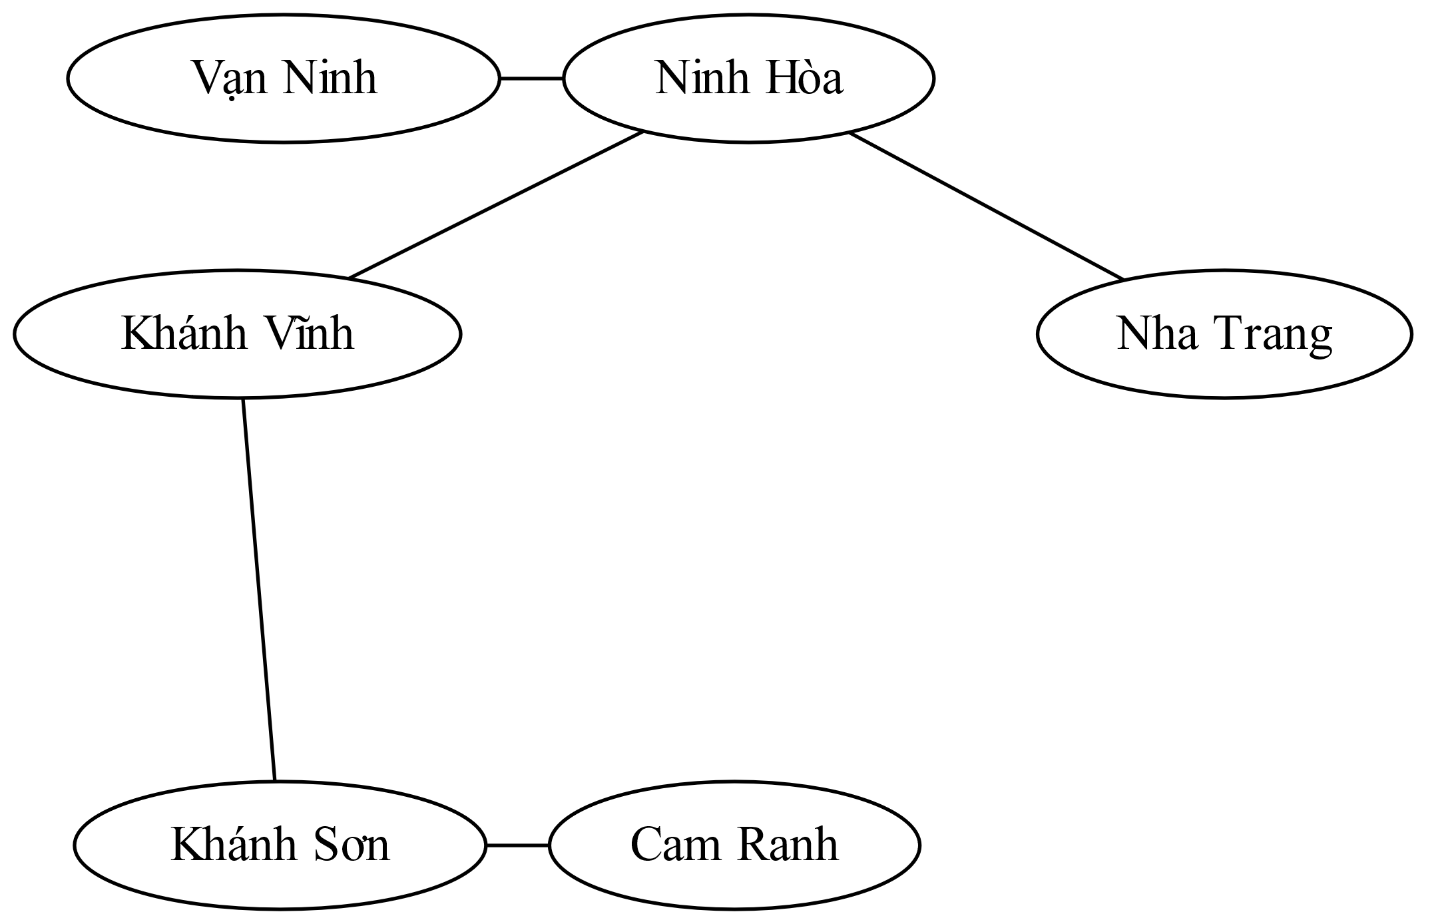
Cutset Conditioning
Choose a cutset
Instantiate the cutset (all possible ways)
Solve the residual CSPs (tree structured)
Compute residual CSP for each assignment

Slide 53
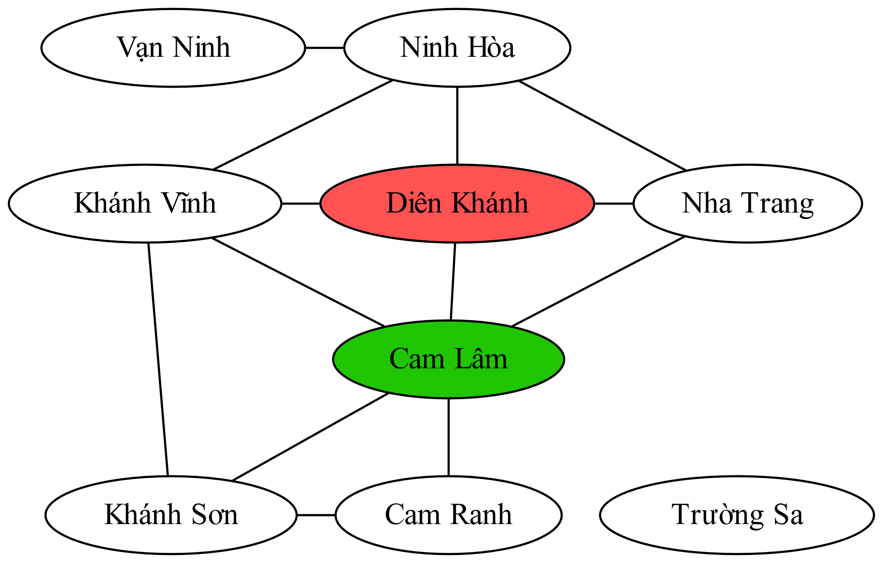
Cutset Conditioning
Vạn Ninh |  |  | Ninh Hòa |  |  | Khánh Vĩnh |  |  | Diên Khánh |  |  | Nha Trang |  |  | Cam Lâm |  |  | Khánh Sơn |  |  | Cam Ranh |  |  | Trường Sa

Slide 54
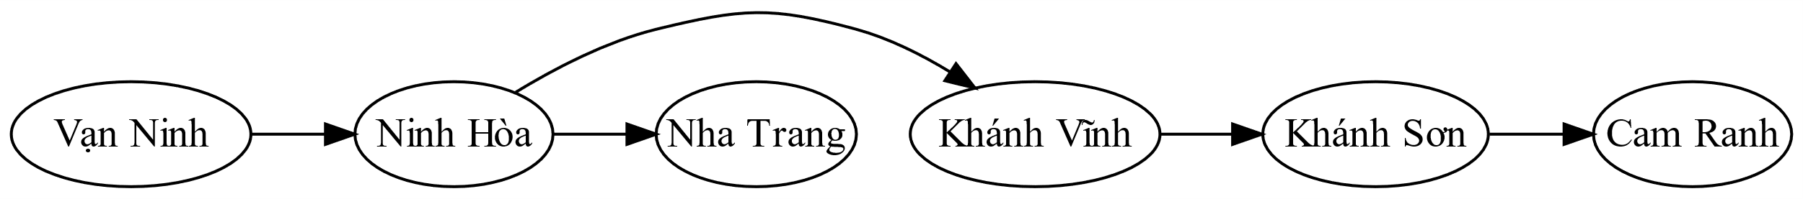
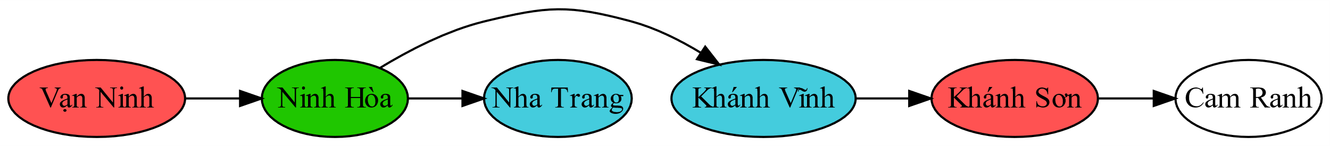
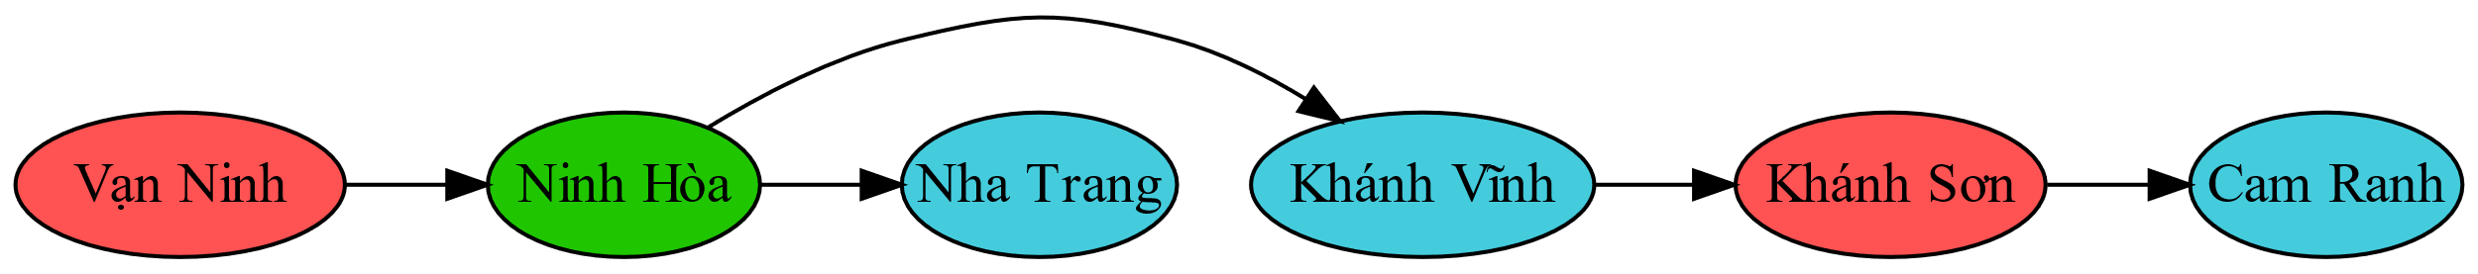
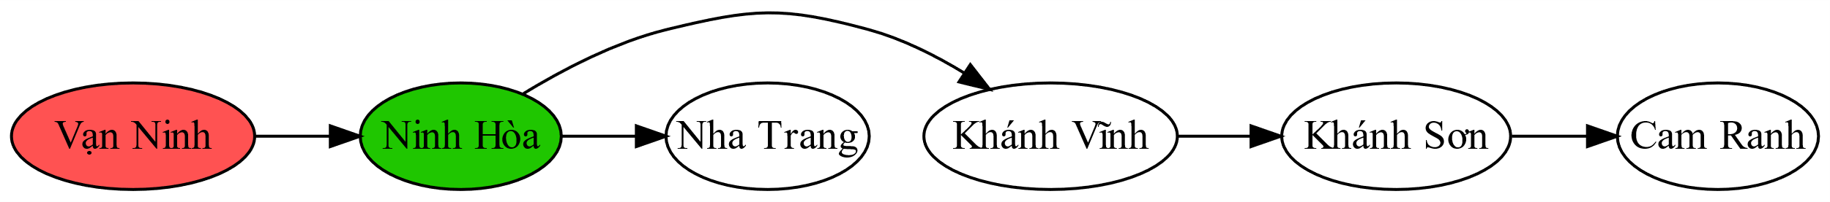
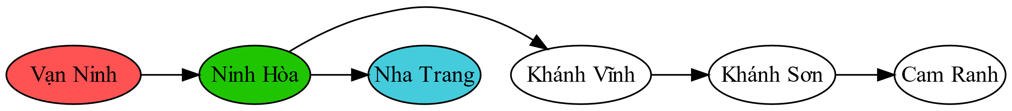


Tree-Structured CSP
Algorithm for tree-structured CSPs:
Order: Choose a root variable, order variables so that parents precede children
Remove backward: For i = n : 2, apply Remove-Inconsistency(Parent(X_{i}),X_{i})
Assign forward: For i = 1 : n, assign X_{i} consistently with Parent(X_{i})
Vạn Ninh |  |  | Ninh Hòa |  |  | Nha Trang |  |  | Khánh Vĩnh |  |  | Khánh Sơn |  |  | Cam Ranh

Slide 55


Tree-Structured CSP

Slide 56

Iterative Improvement

Slide 57
Iterative Algorithms for CSPs
Local search methods typically work with “complete” states, i.e., all variables assigned
To apply to CSPs:
Take an assignment with unsatisfied constraints
Operators reassign variable values
No fringe! Live on the edge.
Algorithm: While not solved,
Variable selection: randomly select any conflicted variable
Value selection: min-conflicts heuristic:
Choose a value that violates the fewest constraints
I.e., hill climb with h(n) = total number of violated constraints

Slide 58
Example: 4-Queens
♛
♛
♛
♛
♛
♛
♛
♛
♛
♛ | 2 | 1 | 0
♛
♛
♛
 |  |  | ♛
♛
♛
♛
 |  |  | ♛
♛
♛
♛
 |  |  | ♛
♛
♛ | 2 | 0 | 1
 | ♛
 |  |  | ♛
♛
 |  | ♛
♛ | 0 | 3 | 1
 |  |  | ♛
♛
 |  | ♛
♛
 |  |  | ♛
♛
 |  | ♛
♛
 |  |  | ♛
♛
 |  | ♛
Notes:
L5D1 – python demos
Coloring – javascript demos

Slide 59



Performance of Min-Conflicts
Given random initial state, can solve n-queens in almost constant time for arbitrary n with high probability (e.g., n = 10,000,000)!
The same appears to be true for any randomly-generated CSP except in a narrow range of the ratio

Slide 60
Summary: CSPs
CSPs are a special kind of search problem:
States are partial assignments
Goal test defined by constraints
Basic solution: backtracking search
Speed-ups:
Ordering
Filtering
Structure
Iterative min-conflicts is often effective in practice

Slide 61

Local Search

Slide 62
Local Search
Tree search keeps unexplored alternatives on the fringe (ensures completeness)
Local search: improve a single option until you can’t make it better
New successor function: local changes
Generally much faster and more memory efficient (but incomplete and suboptimal)
Pretty much unavoidable when the state is “yourself”

Slide 63
Hill Climbing
Simple, general idea:
Start wherever
Repeat: move to the best neighboring state
If no neighbors better than current, quit

Slide 64
Hill Climbing

Slide 65
Hill Climbing Diagram

Slide 66

Hill Climbing Quiz
Starting from X, where do you end up ?
Starting from Y, where do you end up ?
Starting from Z, where do you end up ?

Slide 67


Simulated Annealing
Idea: Escape local maxima by allowing downhill moves
But make them rarer as time goes on

Slide 68

Simulated Annealing
Theoretical guarantee:
Stationary distribution (Boltzmann):
If T decreased slowly enough,
will converge to optimal state!
Is this an interesting guarantee?
Sounds like magic, but reality is reality:
The more downhill steps you need to escape a local optimum, the less likely you are to ever make them all in a row
“Slowly enough” may mean exponentially slowly
Random restart hillclimbing also converges to optimal state…

Slide 69


Genetic Algorithms
Genetic algorithms use a natural selection metaphor
Keep best N hypotheses at each step (selection) based on a fitness function
Also have pairwise crossover operators, with optional mutation to give variety
Possibly the most misunderstood, misapplied (and even maligned) technique around

Slide 70
Example: N-Queens
Why does crossover make sense here?
When wouldn’t it make sense?
What would mutation be?
What would a good fitness function be?

